Slide 1
Decision Tree Analysis
Michael Gilbert

Slide 2
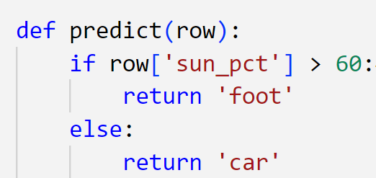
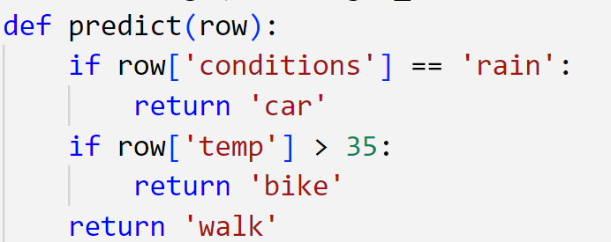
Logical expressions
In a previous topic we wrote a simple rule to predict commute_type based on temperature.
In software development we often write logical expressions to evaluate conditions which can be more complex than a single threshold.

Slide 3
Complex rules
Decision trees are a family of algorithms which attempt to write logical expressions to make our prediction automatically.
The resulting expressions and thresholds are the model which can then be used to make predictions on new data.
Condition == rain
T
F
Car
Temp > 35
T
F
bike
Walk

Slide 4
Under the hood
For the commute data we wrote code to find the threshold iteratively so at first it might not seem like much of a leap to extend this code to writing if statements and thresholds for a larger dataset.
How do we know which columns are ‘important’?
How do we know what threshold values to pick?
How do we know how to split the data?

Slide 5
Splitting
The way we split records depends on the feature type
Continuous attributes usually undergo discretization.
Multi split vs. binary splits
Condition == rain
T
F
Car
Temp > 35
T
F
bike
Walk
Leaf nodes

Slide 6
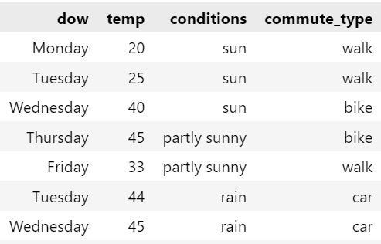
Selecting attributes
Decision trees can be constructed using a calculation of impurity or information gain.
A commonly used metric is the ‘Gini impurity’.
Gini impurity ranges from 0 to 1.
Gini impurity index measures the likelihood of a new random class being misclassified if it were given a random label according to the data.
Calculated per node.

Slide 7
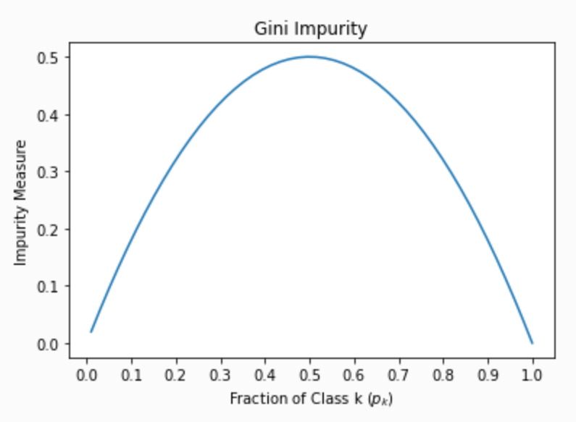
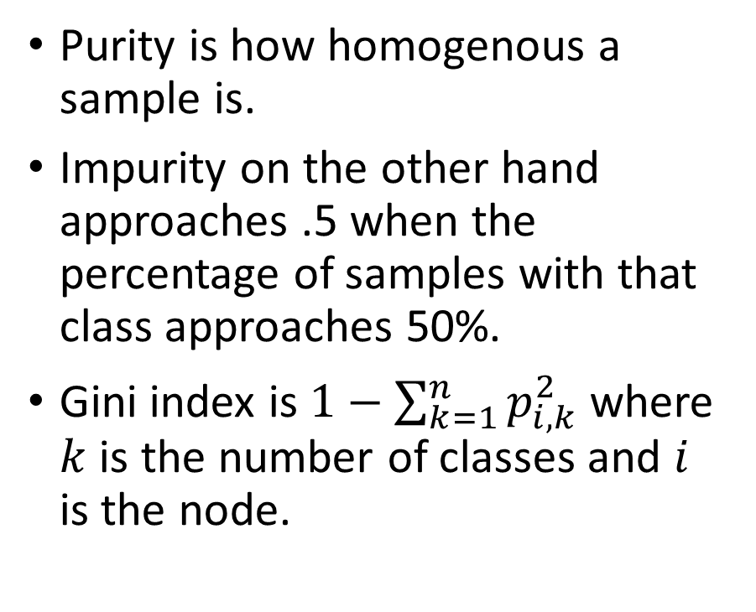
Gini impurity index
Purity is how homogenous a sample is.
Impurity on the other hand approaches .5 when the percentage of samples with that class approaches 50%.
Gini index is $1−\sum_{k=1}^{n}{p_{i,k}^{2}}$ where $k$ is the number of classes and $i$ is the node.

Slide 8
Tree complexity
Selecting features based in purity has some limitations.
Usually features with high cardinality are favored. For example customerID.
This results in small but ‘pure’ child nodes.
Why might this behavior be a problem?

Slide 9
Decision tree pros/cons
Advantages
Relatively fast to train.
Very fast inference time.
Good introspection (especially for small trees)
Robust to noise (think outliers)
Can handle irrelevant attributes
Fewer issues with feature engineering and no need for scaling data
Disadvantages
Issues can occur with interacting attributes due to the ‘greedy’ nature of finding which features to split on. These interacting attributes could be passed over for a feature which is less discriminating.
Interacting attributes are those which can distinguish between classes only when combined. Think lat/lon.
Overfitting.

